Slide 1

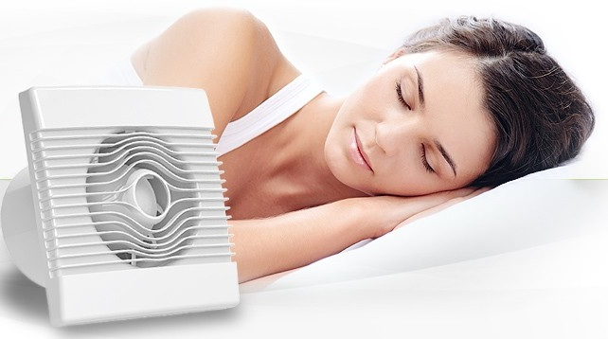


Slide 2
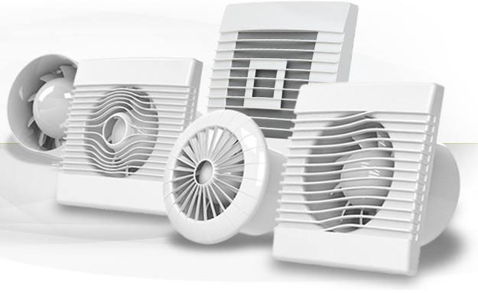
airRoxy LTD is a rapidly growing company, operating in ventilation business. It joins together a team of highly experienced, ambitious and creative people. Our aim is to offer the best quality product, with competitive prices. Professionalism, following the technological development and constant effort to make the offer attractive is what make the clients fully satisfied. Check out our offer and become one of the satisfied users of airRoxy’s products.

Slide 3
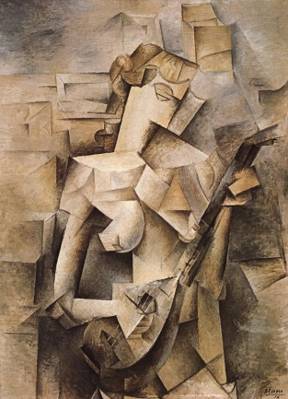
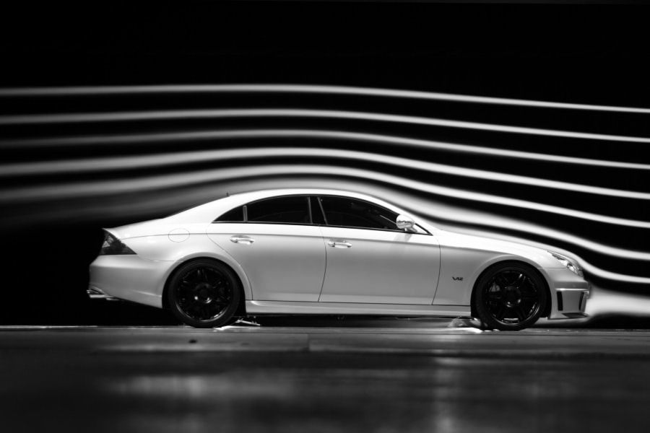
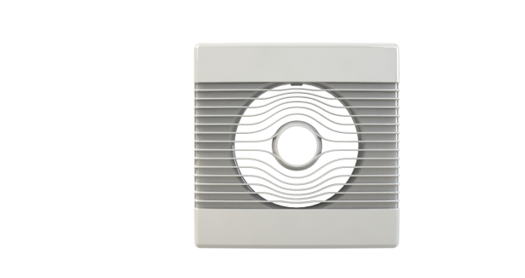
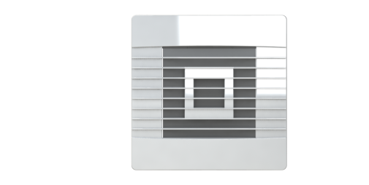
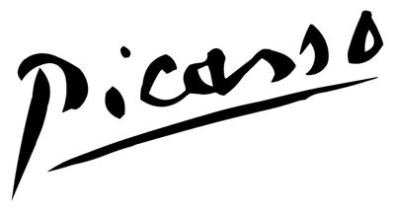
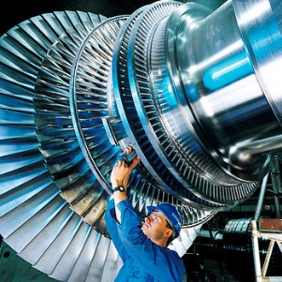

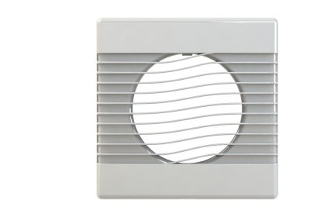
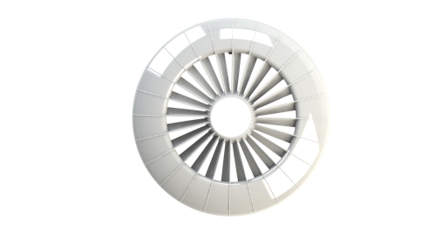
Modern design
What makes airRoxy fans unique is a modern design of the fans, depending on the model inspired by:
the sea wave shape
the nature of an air flow
air turbine
cubistic, universal shape of a square

Slide 4
Modular construction
The usage of modular construction and production unification give us the flexibility in modifying the electronic controllers both with the direct or alternating current sensors and turbines. This solution gives an opportunity to adjust the product to the clients’ requirements and needs. In airRoxy’s fans you can decide to mount ball bearing or sleeve bearing. You can also adjust the motor power to your needs and mount it in different sizes of the fans.

Slide 5
Innovative solutions - turbine
turbine with changeable paddle geometry
large airflow with low acoustic pressure
the turbine adjusted to the particular size and parameters of fan
it is adjusted to the particular size of the fan
location of the turbine at the front site of the fan
motor’s long operating life guaranteed by well balanced turbine

Slide 6
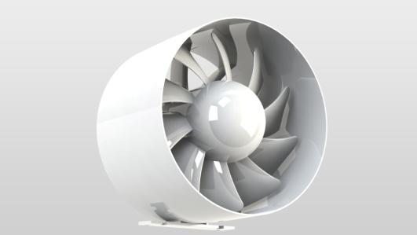
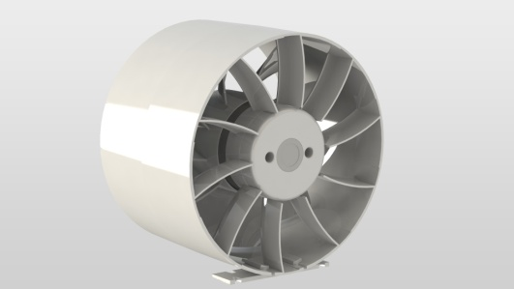
Innovative solutions – fan baffle
One of the innovations is a fan baffle which:
restricts the turbulent air stream
improves the airflow
better the circulation of the air in ducts.
High water-resistance of the motor and the fan itself is ensured thanks to:
tightly fixed elements
components joint together on the basis of clamps
silicone seals

Slide 7
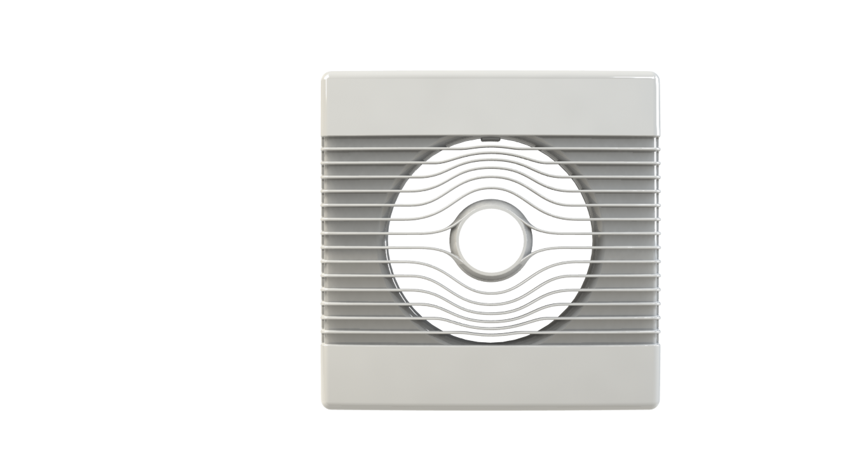
High quality materials
ABS
The casing of the fans is made of the best quality ABS which is characterised by its high durability and scratch resistance.

Slide 8
High quality materials
PC
All the active elements exposed to the high temperature are isolated and made of technical material called polycarbonate. It makes the usage safer and it prolongs the operating life of the fan. These are such elements as motor casing and turbine of the ∅150 fans.

Slide 9
High quality materials
The openings for the wire connection are protected by a silicone seals, it gives an opportunity to adjust the size of the opening to the size of the wires and additionally the motor is protected from the water and humidity. Silicon seals and a special casing construction of the fan ensure high class of waterproofness.
SILIKON

Slide 10
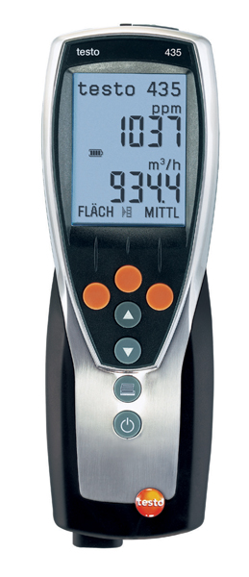

High performance
High performance is confirmed by precise results of three measurement methods of the high quality multifunctional testo 435-4 measuring instrument and:
thermal and vane probe
Pitot tube
temperature and humidity probes

Slide 11
The application of the gravity shutter
airRoxy fans have the gravity shutter, which:
blocks the reverse thrust
puts no restriction on the natural air thrust
has no additional energy consumption
lowers humidity level
is barely audible thanks to the small bulges mounted on the shutters
provides access to the fresh air
is economical and ecological

Slide 12
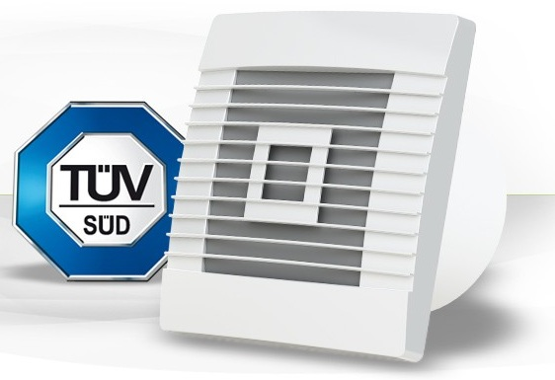

Quality Management System in airRoxy LTD is certified according to ISO 9001. The parameters of the fans are proved by independent entity TŰV SŰD. The examination was concluded with confirmation of CE certification.

Slide 13
airRoxy Sp. z o.o.
ul. Graniczna 40
44-178 Przyszowice
tel. +48 32 239 42 00
email: office@airroxy.com

